Slide 1
Active Server Pages
Prof. Yousef B. Mahdy
Faculty of Computers and Information Sciences
Assiut University

Slide 2
التعامل مع قواعد البيانات
نتعرف في هذا الجزء على طريقة التعامل مع قواعد البيانات و تعريف مسارها و طرق عر ض البيانات المخزنة بالقاعدة ثم نتعرض لطرق تحسينية في عرض البيانات و في الأجزء التالية سأقوم بشرح عمليات الإدخال و الحذف و التعديل على قاعدة البيانات و لنبدأ .
تعرفنا من خلال االأجزء السابقة على كيفية تعامل الصفحات النشطة مع البيانات من ناحية رياضية أو منطقية. لكن من مميزات تكنولوجيا الصفحات النشطة قدرتها على التعامل مع قواعد البيانات المختلفة عن طريق كائن ADO أو ActiveX Data Object و الذي طورته شركة ميكروسوفت و الذي يستخدم في الإتصال بقاعدة البيانات عن طريق OLE-DB و تقنية ODBC مما يتيح لنا التعامل مع أنماط مختلفة من قواعد البيانات مثل أوراكل و SQL Server و العديد العديد و التي سأكتفي هنا بشرح طريقة التوصيل مع قاعدة بيانات من نوع أكسيس .
الكائن ADO هو التقنبة الحديثة للتعامل مع البيانات في قاعدة البيانات و هو يعتمد على ثلاث أشياء و هي connection و recordset وcommand . طبعا الـ connection مسؤولة عن إجراء الإتصال بالخادمProvider مثل الأكسيس , أما recordset فهي مجموعة حقول نستطيع التحكم بها حسب الحاجة و هي ناتج نتيجة استعلام معين , و أخيرا الأمر command و الذي هو عبارة عن نوع الحدث المرتبط بقاعدة البيانات من تعديل و عمليات و غيرها.

Slide 3
Connecting to Data
ASP uses ADO connectivity
  ActiveX Data Objects
Database may reside
  On web server
  On database server connected to web server
    Over Local Area Network
    Over Wide Area Network
    Over Internet

Slide 4


Connecting to Data
asp
database
server
ADO connection
SQL
web
server
Internet
html
html

Slide 5
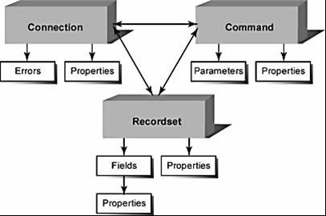

Slide 6
ADO (ActiveX Data Objects)
Microsoft Standard
A programming interface providing data access to programming languages such as VBScript
connection
recordset
command
errors

Slide 7
ADO Object Model
objects
connection
recordset
command
errors
open
execute
close
bof
eof
commandtext
count
item
properties
open
movefirst
movenext
close
execute
methods

Slide 8
ADO Connections
Defined by its ConnectionString property
  Series of name and value pairs separated from each other by semicolons
  "Driver={SQL Server}; Server=gwen; Database=intern; User Id=bob; Password=xxx;"
Three Types of Connections
  ODBC DSN
  ODBC DSN-less
  OLE DB

Slide 9
ODBC DSN Connections
ODBC (Open Database Connectivity)
  Open Standard developed in early 1990s
  Provides simple programming interface to relational databases
DSN (Data Source Name)
  A saved entry in the Windows ODBC applet
  Defines all connection information
  Provides a simple name to handle connectivity
Web server admin must make ODBC entry
asp
ado
odbc
data
Conn.Open "DSN=DSNname;" & _
"Uid=Username;" & _
"Pwd=Password;"

Slide 10
ODBC DSN-less Connections
Still Uses ODBC
Does not use a saved DSN entry
Advantages
  Quicker. Saves a call to Windows Registry.
  Avoids having to have the DSN created on the web server.
  More portable.
  More flexible. Can pass database names as variables.
asp
ado
odbc
data
Conn.Open "Driver={Microsoft Access Driver (*.mdb)};" & _
"Dbq=" & server.mappath("Internship.mdb") & ";" & _
"Uid=Username;" & _
"Pwd=Password;"

Slide 11
OLE DB Connections
OLE DB
  Microsoft standard – supported only on Microsoft operating systems
  Provides access to relational and non-relational data
  Generally less prone to errors than ODBC
  Preferred method
asp
ado
ole db
data
Conn.Open "Provider=Microsoft.Jet.OLEDB.4.0;" & _
"Data Source=" & server.mappath("Internship.mdb") & ";" & _
"User Id=Username;" & _
"Password=Password;"

Slide 12
Sample ADO Connection Strings
Access
Conn.Open "Provider=Microsoft.Jet.OLEDB.4.0;" & _
"Data Source=" & server.mappath("Internship.mdb") & ";" & _
"User Id=admin;" & _
"Password=;"
Oracle
Conn.Open "Provider=msdaora;" & _
"Data Source=TRINITY.MYORG.COM;" & _
"User Id=myusername;" & _
"Password=mypassword;"
SQL Server
Conn.Open "Provider=sqloledb;" & _
"Data Source=gwen;" & _
"Initial Catalog=internship;" & _
"User Id=myusername;" & _
"Password=mypassword;"

Slide 13
SQL and RecordSet Objects
The ADODB.Connection object has a method named Execute
  give it an SQL command (as a parameter)
  It creates a RecordSet object
The RecordSet object contains the result of the SQL query.
Set result=dbconn.Execute("SELECT * FROM Password")
Resulting RecordSet object
This is the SQL Query

Slide 14
RecordSet Objects
A RecordSet object holds a collection of records (from the database) and has some methods:
  EOF() : boolean that indicates there are no more records.
  MoveNext(): moves to the next record
  MovePrevious(): move to prev. record
  MoveFirst(): move to the first record
  Lots more… (check an ASP reference for the entire list)

Slide 15
Opening a Connection and Recordset (simple syntax)
Conn object is created as an ADODB Connection object
Set Conn = Server.CreateObject("ADODB.Connection")
Conn.Open "Provider=Microsoft.Jet.OLEDB.4.0;" & _
"Data Source=" & server.mappath(“my.mdb") & ";" & _
"User Id=Admin;" & _
"Password=;"
SQL = "Select StudentID, LastName, FirstName From Student“
Set RS = Conn.Execute(SQL)
Connection opened using OLE DB and server.mappath from ASP Object Model
SQL used to set fields and records for recordset
Execute method of connection object called with SQL variable to create recordset

Slide 16
Opening a Connection and Recordset (alt. syntax)
Set Conn = Server.CreateObject("ADODB.Connection")
Conn.Open "Provider=Microsoft.Jet.OLEDB.4.0;" & _
"Data Source=" & server.mappath(“my.mdb") & ";" & _
"User Id=Admin;" & _
"Password=;"
SQL = "Select StudentID, LastName, FirstName From Student"
Set RS = Server.CreateObject("ADODB.Recordset")
RS.Open SQL, Conn, 3, 1, 1
Recordset object is created as an ADODB recordset
Recordset is opened using SQL variable, Conn object, and specific parameters for cursortype, locktype, and options

Slide 17
Cursortype controls navigation
CursorType | ASP Code | Description
OpenForwardOnly | 0 | Default. Can only scroll forward through records and is unaware of changes by other users. Simplest, lowest-overhead, fastest, and most limited CursorType.
OpenKeyset | 1 | Maintains list of primary key values. Can move forward and backward. Also RecordCount property works. Changes and deletions by other users are visible, though not additions.
OpenDynamic | 2 | Allows for all types of movement and is aware of additions, changes, and deletions by other users. Has most power and requires most overhead. It should be avoided in most cases
OpenStatic | 3 | Read-only copy of records. Additions, changes, or deletions by other users are not visible. Can scroll both forward and backward and use the Recordcount property.

Slide 18
Locktype controls record locking in multi-user environment
LockType | ASP Code | Description
LockReadOnly | 1 | Default. Cannot make any changes to the data. So nothing is locked.
LockPessimistic | 2 | Locks each record whenever a user edits anything. Other users prevented from making changes until the lock is released. Safest lock setting that allows changes. However, it can lead to users waiting for locks to clear.
LockOptimistic | 3 | Locks a record only when it physically gets updated. Can lead to users receiving error messages. Best used when there is only a small chance that a second user may edit a record while the recordset is open.
LockBatchOptimistic | 4 | Used with disconnected recordsets in which the recordsets are updated locally and modifications are sent back to the database in a batch.

Slide 19
Options controls how source parameter is interpreted
OptionType | ASP Code | Description
cmdText | 1 | Default. The Source is evaluated as an SQL command.
cmdTable | 2 | The Source is evaluated as the name of a table in the connection data source. All fields and all records are returned.
cmdStoredProcedure | 4 | The Source is evaluated as the name of a stored procedure in the connection data source.
Note: In specifying recordset parameters, you must use
the ASP Code numbers unless you define the various
cursor, lock, and option types as constants.

Slide 20
Can Place Connection Code in Include Files
dataconnection.asp
<%
accessdb="db\followup.mdb"
Set Conn = Server.CreateObject("ADODB.Connection")
Conn.Open "PROVIDER=Microsoft.Jet.OLEDB.4.0;” & _
“DATA SOURCE=" & server.mappath(accessDB) & _
";Jet OLEDB:Database;"
%>
another.asp (in same directory)
<html>
<head>
<title>Follow-Up Management</title>
<!-- #include file="dataconnection.asp" -->
</head>

Slide 21
Closing Connection and Recordset Objects
Close and clear connection and recordsets from memory when finished with them
<%
RS.Close
Set RS=Nothing
Conn.Close
Set Conn=Nothing
%>

Slide 22
Example:
في المثال التالي سأسرد مثالا بسيطا يعرض بيانات جميع الطلبة المسجلين مثلا في مدرسة , لكن أود أن نفرض أن هناك جدولا للطلبة به حقل لأسماء الطلبة و حقل لأرقام جلوسهم و حقل للصف على الترتيب التالي studentName و studentNo و class وذلك فى قاعدة بيانات باسم university حاليا بها الجدول students فقط.
<%@codePage=1256%>
<html>
<%
'1-Dimension variables
  Dim Ado 'Holds the Database Connection Object
  Dim MyRs 'Holds the recordset for the records in the database
  Dim MySQL 'Holds the SQL query to query the database
  Dim ConnectionString
  Dim MySQL 'Holds the SQL query to query the database
  Dim ConnString

Slide 23
'2-Create an ADO connection object
Set ADO=Server.CreateObject("ADODB.Connection")
'3-Set an active connection to the Connection object using a DSN-less connection
ConnString="Provider=Microsoft.Jet.OLEDB.4.0;"
ConnString=ConnString & "Data Source="
ConnString=ConnString & Server.MapPath(“.\university.mdb")
Set ADO=Server.CreateObject("ADODB.Connection")
ADO.ConnectionString =ConnString
ADO.Open
'4- Create an ADO recordset object
Set MyRs = Server.CreateObject("ADODB.Recordset")
'5-Initialise the strSQL variable with an SQL statement to query the database with
strSQL = " Select * from students "
'6- Open the recordset with the SQL query
MyRs.Open strSQL, ado

Slide 24
'7- Loop through the recordset
MyRs.moveFirst
Do While not MyRs.EOF
'Write the HTML to display the contents of the recordset
Response.Write "<br>"
Response.Write MyRs("studentName")
Response.Write "<br>"
'Move to the next record in the recordset
MyRs.MoveNext
Loop
'8- Reset server variables
MyRs.Close
Set MyRs = Nothing
ado.close
Set ado = Nothing
%>
</body>
</html>

Slide 25
استعراض النتائج فى جدول
MyRs.moveFirst
Do While not MyRs.EOF
Response.Write("<tr><td>" & MyRS("studentName") & "</td><tr>" & vbNewLine)
MyRs.MoveNext
Loop
MyRs.Close
Set MyRs = Nothing
ado.close
Set ado = Nothing
%>
</body>
</html>

Slide 26
Example:
عرض كل محتويات الجدول students على هيئة جدول وهذا يتطلب معرفة عدد الحقول فى السجل واسماء هذه الحقول حتى تستخدم هذه الأسماء كأسماء للأعمدة التى سوف تعرض. معرفة عدد الحقول والتى سوف تخزن فى المتغير howmanyfields يتم عن طريق الجملة :
howmanyfields=MyRs.fields.count -1
معرفة اسماء الحقول يتم عن طريق الجملة MyRs(i).name حيث I هى رقم الحقل ويبدأ الترقيم من 0. ولكى نخرج البيانات على شكل جدول نقوم بالأتى:
1. تكوين جدول
<table border="1">

Slide 27
2. كتابة عناوين الأعمدة باستخدام اسماء الحقول فى سطر وفى كل عمود نضع اسم من اسماء الحقول:
<tr>
<td valign="top">---</td>
<% 'Put Headings On The Table of Field Names
for i=0 to howmanyfields %>
<td><b><%=MyRs(i).name %></b></td>
<% next %></tr>
3. نستخدم الجملة Do While/loop لبناء حلقة تكرارية و في كل مرة تقوم الحلقة بطباعة سجل كامل فى صف بواقع حقل لكل عمود.
<% do while not MyRs.eof %>
<tr>
<% for i = 0 to howmanyfields%>
<td valign="top"><%=MyRs(i)%></td>
<% next %>
</tr>
<% MyRs.movenext
loop %>

Slide 28
Displaying Data from a Recordset
student_browse1.asp
<% If Not (RS.BOF and RS.EOF) Then %>
<table border="1">
<tr>
<td>Student ID</td>
<td>Last Name</td>
<td>First Name</td>
<td>College</td>
</tr>
<%Do Until RS.EOF%>
<tr>
<td><%Response.Write(RS("StudentID"))%>&nbsp;</td>
<td><%Response.Write(RS("LastName"))%>&nbsp;</td>
<td><%Response.Write(RS("FirstName"))%>&nbsp;</td>
<td><%Response.Write(RS("College"))%>&nbsp;</td>
</tr>
<%
RS.MoveNext
Loop
End If
%>
Avoids error from empty recordset
Loop until end of recordset
Display recordset fields plus space to maintain cell even if field is null
Don’t forget to move to next record

Slide 29
Filling a Select Dropdown from a Recordset
<select size="1" name="Dept" tabindex="1">
<option selected>ALL</option>
<%
SQL = "Select DeptType From DeptType"
Set RS = Conn.Execute(SQL)
If Not (RS.BOF and RS.EOF) Then
Do Until RS.EOF
%>
<option><%Response.Write(RS("DeptType"))%></option>
<%
RS.MoveNext
Loop
End If
RS.Close
Set RS=Nothing
%>
SQL for dropdown
Loop through recordset and write field into options
student_search2.asp

Slide 30
Custom-built SQL from Form Variables
<%
SQL = "Select StudentID, LastName, FirstName, College From Student"
If Request.Form("Dept")<>"ALL" Then
Crit = "DeptType = '" & Request.Form("Dept") & "'"
End If
If Request.Form("GPA")<>"" Then
If Crit<>"" Then
Crit = Crit & " AND "
End If
Crit = Crit & "GPA >= " & Request.Form("GPA")
End If
If Crit<>"" Then
SQL = SQL & " Where " & Crit
End If
Set RS = Conn.Execute(SQL)
%>
Text values need to be embedded in single quotes
student_browse2.asp

Slide 31
Custom-built Querystrings
<table border="1">
<tr>
<td>Last Name</td>
<td>First Name</td>
<td>College</td>
<td>&nbsp;</td>
</tr>
<%Do Until RS.EOF%>
<tr>
<td><%Response.Write(RS("LastName"))%>&nbsp;</td>
<td><%Response.Write(RS("FirstName"))%>&nbsp;</td>
<td><%Response.Write(RS("College"))%>&nbsp;</td>
<td><a href="student_info.asp?studentid=
<%Response.Write(RS("StudentID"))%>">View</a></td>
</tr>
<%
RS.MoveNext
Loop
%>
student_search3.asp
student_browse3.asp
student_info.asp
ASP embedded between variable = and final "

Slide 32
Setting Session Variables from Recordsets
Custom-built SQL using login form
SQL = "Select EmpID from Employer " & _
"Where Username = '" & Request.Form("username") & "' " & _
"And Password = '" & Request.Form("password") & "'"
Set rsUser=Conn.Execute(SQL)
If not (rsUser.EOF and rsUser.BOF) Then
Session.Contents("EmpID")=rsUser("EmpID")
Response.Redirect(Request.Querystring("page"))
Else
ErrMsg = "Invalid User Name or Password"
End If
Session variable set to recordset value
Redirect to page name passed by querystring
employer_logon.asp
User Name: 1
Password: 1

Slide 33
Inserting Record from Form Fields
internshipopp_entry.asp
internshipopp_entry_action.asp
Data validation
'Check Data
If Request.Form("title")="" Or Request.Form("city")="" _
Or Request.Form("state")="" Or Request.Form("Descrip")="" Then
ErrMsg = "Must enter all form fields."
ElseIf Len(Request.Form("Descrip"))>65535 Then
ErrMsg = "Internship Description limited to 65,535 characters."
Else
'Insert New Record
SQL = "Insert into InternshipOpp (EmpID, InternshipTitle, “ & _
"City, State, Description) " & _
"Values (" & _
Session.Contents("EmpID")& "," & _
"'" & CheckString(Request.Form("Title")) & "'," & _
"'" & CheckString(Request.Form("City")) & "'," & _
"'" & CheckString(Request.Form("State")) & "'," & _
"'" & CheckString(Request.Form("Descrip")) & "'" & _
")“
Conn.Execute(SQL)
If conn.errors.count>0 Then
For counter = 0 to conn.errors.count
ErrMsg = ErrMsg & conn.errors(counter).description & "<br />"
next
End If
End If
Custom-built Insert SQL using form fields
Call to CheckString function to handle apostrophes
Using Error object to check for errors

Slide 34
Using Forms to Edit Records
If Request.Querystring("InternshipID")<>"" Then
SQL = "Select * From InternshipOpp " & _
"Where EmpID = " & Session.Contents("EmpID") & " " & _
"And InternshipID = " & Request.Querystring("InternshipID")
Set RS = Conn.Execute(SQL)
thisTitle = RS("InternshipTitle")
thisID = RS("InternshipID")
RS.Close
End If
---
<input type="text" name="title" size="40" maxlength="40"
Value="<%Response.Write(thisTitle)%>">
<input type="hidden" name="InternshipID"
Value="<%Response.Write(thisID)%>">
Selected record loaded into recordset and used to set variables
internshipopp_browse.asp
internshipopp_entry.asp
internshipopp_entry_action.asp
Size sets textbox size. Maxlength sets max number of characters. Needed when saving data to database text fields.
Variables loaded into form field values and primary key value placed in hidden field

Slide 35
Record Update & Delete Code
'Update Existing Record
SQL = "Update InternshipOpp " & _
"Set InternshipTitle = '" & CheckString(Request.Form("Title")) & "'," & _
"City = '" & CheckString(Request.Form("City")) & "'," & _
"State = '" & CheckString(Request.Form("State")) & "'," & _
"Description = '" & CheckString(Request.Form("Descrip")) & "' " & _
"Where InternshipID = " & Request.Form("InternshipID")
'Delete Existing Record
SQL = "Delete from InternshipOpp " & _
"Where EmpID = " & Session.Contents("EmpID") & " " & _
"And InternshipID = " & Request.Querystring("InternshipID")
internshipopp_del.asp
internshipopp_entry_action.asp

Slide 36
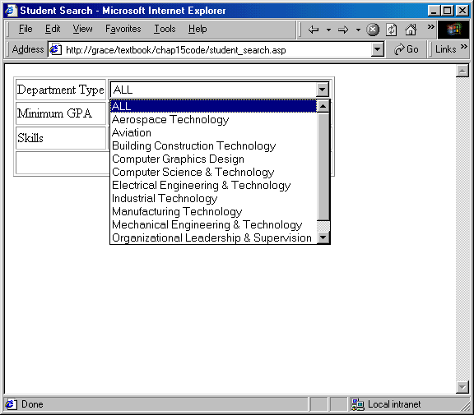
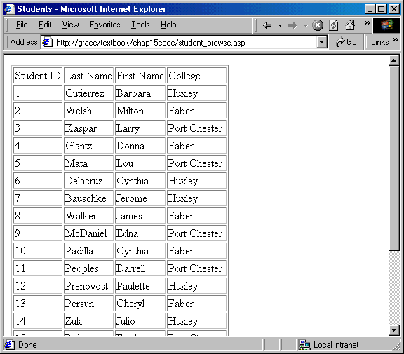
Search & Browse User Interface
Search criteria set here
Used to limit what is displayed here

Slide 37
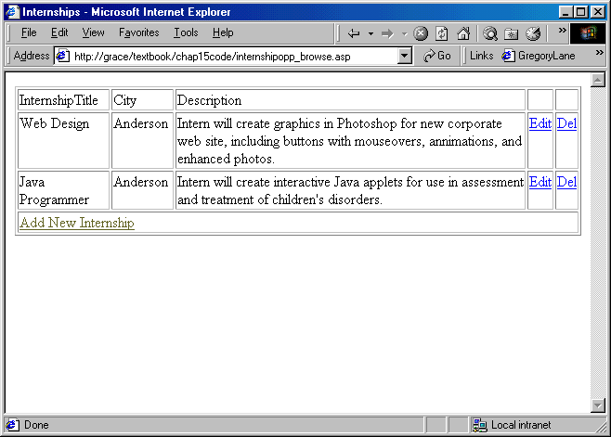
Browse-Insert-Edit-Delete User Interface
All major database functionality provided on one screen

Slide 38
ASP File Naming
Many ASP files in a web app
Name files consistently
Name files logically
  So they group together when sorted
  So their purpose is clear
internshipopp_browse.asp
internshipopp_del.asp
internshipopp_entry.asp
internshipopp_entry_action.asp
student_browse.asp
student_info.asp
student_search.asp

Slide 39
Advantages of database-driven web applications
Content can change automatically
A few database-driven web pages can generate nearly unlimited content
Updating of content can be delegated without compromising security
Updating of content can be delegated to people without XHTML skills

Slide 40
Relational Database Concepts
Table
Field
CD_ID | Title | Artist | Genre
1 | The Wall | Pink Floyd | Rock
2 | Blue Train | John Coltrane | Jazz
3 | Requiem | W.A. Mozart | Classical
Record

Slide 41
Relational Database Concepts
Primary Key
CD_ID | Title | Artist | Genre
1 | The Wall | Pink Floyd | Rock
2 | Blue Train | John Coltrane | Jazz
3 | Requiem | W.A. Mozart | Classical
Parent
“One”
CD_ID | Track | TitleTitle
1 | 1 | In The Flesh?
1 | 2 | The Thin Ice
2 | 5 | Lazy Bird
3 | 2 | Kyrie
Child
“Many”
Foreign Key

Slide 42
What is SQL?
Invented as a language to manipulate relational data
ANSI standard
Includes commands to:
  Select data
  Insert data
  Update data
  Delete data
  Create tables, relationships, views, etc.
Used extensively in web programming

Slide 43
General SQL Tips
Not case sensitive for field names, table names, and key words
Case sensitive for values in some database systems
Field and table names with spaces must be enclosed in [brackets]

Slide 44
Select From
Reports Selected Fields from a Table
Syntax
SELECT Field | Field, Field, Field | * FROM Table
Example
1. List the phone number of every employer
Select Phone From Employer
2. List the Organization and contact name of every employer
Select Organization, ContactFirst, ContactLast From Employer
3. List all the information of every employer
Select * From Employer

Slide 45
Basic Where Clauses
Determines Which Rows to Include
Syntax
SELECT Field | Field, Field, Field | * FROM Table
Where Field | Expression comparison Value | Field
Examples
1. List the names of every Huxley student.
Select lastname, firstname From student Where college='Huxley'
2. List the names of every student with a GPA over 3.5.
Select lastname, firstname From student Where gpa>3.5

Slide 46
How to Enclose Values in Where Clauses
Datatype
Access
SQL Server
Oracle
MySQL
Text
Quotes (' ')
Quotes (' ')
Quotes (' ')
Quotes (' ')
Date
Pound signs (# #)
Quotes (' ')
Quotes (' ')
Quotes (' ')
Numeric/Currency
Just value
Just value
Just value
Just value
Yes/No
True or False
1 (T) or 0 (F)
1 (T) or 0 (F)
1 (T) or 0 (F)

Slide 47
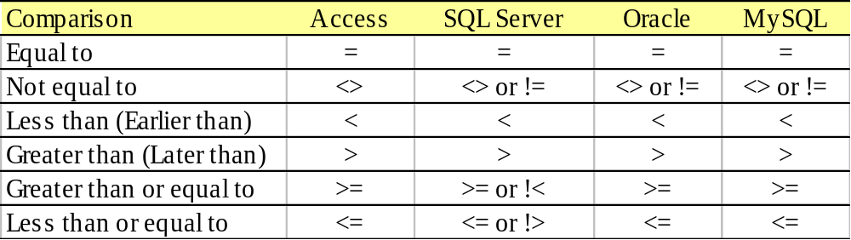
Basic Comparison Operators

Slide 48
Like and Wildcards
Selects based on part of a field value
Syntax
SELECT Field | Field, Field, Field | * FROM Table
Where Field | Expression comparison Value | Field
Examples
List the names and skills of every student whose skills include ASP.
Select lastname, firstname, skills From student Where skills Like '%ASP%'
2. List the names of every student whose last name begins with G.
Select lastname, firstname From student Where lastname Like 'G%'
3. List the web site URL of any employer with a .com domain.
Select url From employer Where url Like '%.com'

Slide 49
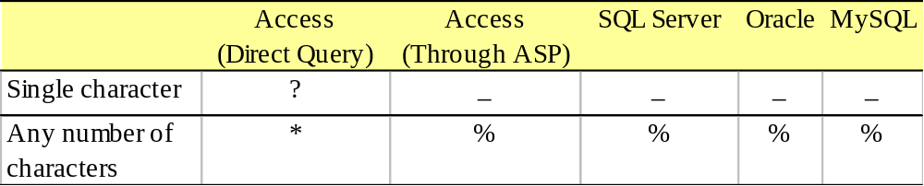
Wildcards

Slide 50
Between
Selects a range of values
Syntax
SELECT Field | Field, Field, Field | * FROM Table
Where Field | Expression Between Value | Field And Value | Field
Examples
List the names and completion date of every student who will complete a degree during 2006.
Select lastname, firstname, completiondate From student
Where completiondate between #1/1/06# and #12/31/06#
2. List all GPAs between 3.00 and 3.99.
Select gpa From student Where gpa between 3 and 3.99
3. List the names of all students with last names between A and M.
Select lastname, firstname from student where lastname between 'A' and 'Mzzz'

Slide 51
Is Null
Selects empty values
Syntax
SELECT Field | Field, Field, Field | * FROM Table
Where Field is Null
Examples
1. List all the information about any student who has left the GPA field blank.
Select * from student where gpa is null

Slide 52
And & Or
Syntax
SELECT Field | Field, Field, Field | * FROM Table
Where Field | Expression comparison Value | Field
And|Or Field | Expression comparison Value | Field
Examples
1. List the names, college, and degree of every student who will earn a BS degree from Huxley.
Select firstname, lastname, college, degree From student Where college='Huxley' and degree='BS'
2. List the names, college, and degree of every student who will earn either a BS degree from Huxley.
Select firstname, lastname, college, degree From student Where college='Huxley' or degree='BS'

Slide 53
Not
Reverses any selection
Syntax
SELECT Field | Field, Field, Field | * FROM Table
Where NOT (Field comparison Value | Field)
Examples
1. List the last name, degree, and college of every student who is pursuing a BS degree from a college other than Huxley.
Select lastname, degree, college From student where Not (college='Huxley') And degree='BS'
2. List the names, college, and degree of every student who will not earn a BS degree from Huxley.
Select lastname, degree, college From student where Not (college='Huxley' and degree='BS')

Slide 54
Order By
Syntax
SELECT Field | Field, Field, Field | * FROM Table Order by Field, Field DESC
Examples
1. List the organization names of every employer in alphabetical order.
Select Organization From Employer Order by Organization
2. List the names and GPA of every student in order with the highest GPAs first.
Select Lastname, Firstname, gpa from Student Order by gpa DESC
3. List the names and major of every Huxley student grouped by major and sorted within major by last name.
Select Lastname, Firstname, Major From Student Where college='Huxley' Order by Major, Lastname

Slide 55
Calculated Columns
Syntax
SELECT Expression As Column_Name FROM Table
Examples
1. List the number of GPA points over or under 2.5 for each student.
Select gpa-2.5 as GPA_Diff from Student
2. List the combined first name and last name of every student.
Select Firstname + ' ' + LastName as Student_Name From Student
3. List the word ‘Student:’ followed by last name for every student.
Select 'Student: ' + LastName as StudentName from Student

Slide 56
Insert
Syntax
INSERT INTO Table (Field, Field, Field) Values (value, value, value)
INSERT INTO Table (Field, Field, Field) SELECT Field, Field, Field From Table
Examples
1. Add a record to the Industry table with the value of ‘Construction’ for the Industry field.
Insert Into Industry (Industry) Values ('Construction')
2. Select a list of all unique combinations of College, Major, and DeptType from the Student table and insert it into matching fields in the CollegeMajor table.
Insert Into CollegeMajor (College, Major, DeptType) Select Distinct College, Major, DeptType From Student

Slide 57
Delete
Syntax
DELETE FROM Table Where Field | Expression comparison Value | Field
Examples
1. Delete any records from the Industry table with the value of ‘Construction’ for the Industry field.
Delete From Industry Where Industry='Construction'
2. Delete the Student record for StudentID 2.
Delete From Student Where StudentID=2

Slide 58
Update
Syntax
Update Table Set Field=Value, Field=Value, Field=Value Where Field | Expression comparison Value | Field
Examples
1. Update the GPA to 3.21 for StudentID 2.
Update Student Set GPA=3.21 Where StudentID=2
2. Add ‘Java’ to the list of skills for StudentID 1.
Update Student Set Skills=Skills+'Java ' Where StudentID=1
3. Change the major to ‘Computer Science’ and the DeptType to ‘Computer Science & Technology’ for StudentID 7..
Update Student Set Major = 'Computer Science', DeptType='Computer Science & Technology' Where StudentID=7

Slide 59
Other Uses for SQL
SQL is a complete Data Definition Language
Extended uses of Sub-Queries in Select and From clauses
SQL has several other commands for advanced querying
Each database system provides extensions to SQL

